Slide 1
Baton Rouge Urban Renewal and Mobility Plan (BUMP) Unsolicited P3 Proposal
October 20, 2015
LTA Briefing

Slide 2
Agenda
Introductions
Proposal/Project Overview
HNTB Approach
  Construction and O&M Costs
  Tolling Configuration and Costs
  Traffic and Revenue Analysis
  Preliminary Financial Feasibility
Findings
Questions

Slide 3
Introductions
Jeff Burst, PE, DOTD PM
Cheryl Duvieilh, DOTD Executive Counsel
Shawn Wilson, DOTD Chief of Staff
Ann-Therese E. Schmid, Nossaman LLP, Contract Attorney
John Basilica: HNTB, Project Manager, Baton Rouge, LA
Brad Guilmino: HNTB, Dir. Fin Services, New Orleans, LA

Slide 4
Purpose
Brief members of LTA on the BUMP Proposal feasibility study
  Independent review required of unsolicited proposals under RS Title 48, Section 2076
Present findings of Final Report
Answer questions

Slide 5
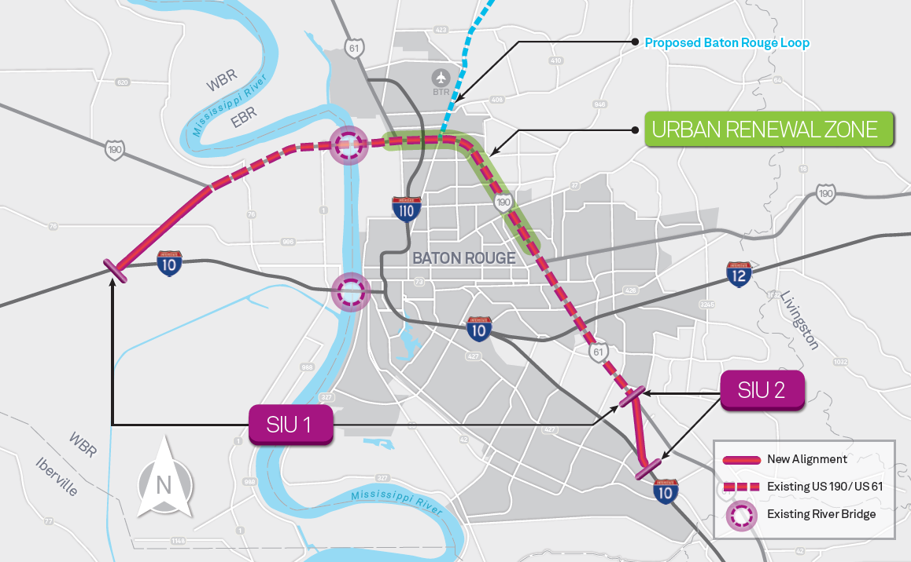
AECOM BUMP Alignment
  Primarily utilizes existing US-190 and US-61 corridors
  SIU 1 is approximately 21 miles (SIU-2 was not included)

Slide 6
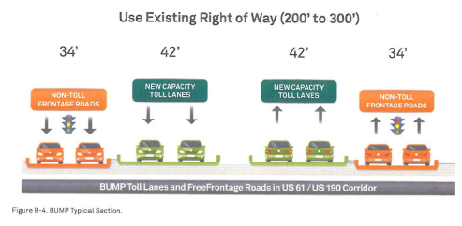
AECOM BUMP Configuration
“Expected to operate as all-electronic toll collection, allowing full-speed travel throughout the corridor”
AECOM’s “planning level estimates indicate that these new features of the BUMP represent approximately $700-800 million of implementation cost.”
Source: AECOM BUMP Proposal (public, non-confidential portion)

Slide 7
HNTB Approach
Construction and O&M Costs
Tolling Configuration and Costs
Traffic and Revenue Analysis
Preliminary Financial Feasibility

Slide 8
Design and Cost Methodology
HNTB conceptual design developed
  Identified components and considerations to meet design standards and traffic operations for facilities of this type
  Cost estimate based on the following:
    Roadway: application of the typical section to computer generated line work representing various project features
    Elevated structures: per square foot
    Additional costs related to more unique components

Slide 9
Roadway Capital Cost Estimate
 | Cost
Capital Cost of Roadway Construction | $554M
Engineering Fees (10% of Capital Cost) | $55M
Construction Cost Contingency (30% of Capital Cost) | $166M
HNTB Total Roadway Capital Cost Estimate: | $775M¹
Conceptual level estimate
Majority of elevated structures were estimated at $120 per square foot
Due to complexity, some portions of the elevated sections were estimated at $365 per square foot
$856M - Costs inflated to mid-point of construction (2019) @ 2.5%
  ¹ The estimated roadway capital costs shall be considered a preliminary conceptual estimate. The preliminary level of development, potential for increases in the scope of work and history of significant variability in costs associated with the development of large, complex projects require continual refinement and additional scrutiny of the estimated costs.

Slide 10
Routine Operations & Maintenance Estimate
Methodology
  Assumed that only tolled roads would be maintained by concessionaire
  LADOTD maintains the frontage roads
Routine Maintenance*
  Flat rate of $30k per lane mile per year (2014 dollars)
  Ramp-up: Start at 10% of costs in Year One to full rate ($30k) in Year Ten
  Expenses are escalated at 2.5% in the financial feasibility model
Year (Year 1 is 2022) | Maintenance Expense (2014 dollars)
5 | $1,044,843
10 | $2,089,687
15 | $2,089,687
20 | $2,089,687
25 | $2,089,687
30 | $2,089,687
35 | $2,089,687
40 | $2,089,687
*Based on industry standards

Slide 11
Renewal & Replacement (R&R) Works Estimate
Methodology
  Assumed that only tolled roads would be maintained by concessionaire
  LADOTD maintains the frontage roads
R&R Works*
  Annual R&R costs to equal 0.05% of cumulative construction costs annually beginning 10 years after initial construction
  Ramp-up: Costs grow at 0.05% until reaching 0.75% annually
  Expenses are escalated at 2.5% in the financial feasibility model
Year | Expense (2014 dollars) | % increase
5 | $2,410,000
10 | $2,410,000
15 | $2,595,939 | 0.025
20 | $3,157,992 | 0.05
25 | $4,326,246 | 0.075
30 | $6,210,886 | 0.075
35 | $8,916,530 | 0.075
40 | $12,800,832 | 0.075
*Based on industry standards

Slide 12
Tolling Overview
All Electronic Tolling (AET)
  Free flow, no toll booths
Toll gantries throughout the corridor
  Mainline toll zones and ramp toll zones
Frontage roads and Old Mississippi River bridge are toll-free
Tolling Capital Costs
  $18M (2014 dollars)
Tolling Operations / Maintenance Costs
  Roadside Toll Collection System: $558K/yr with $11M upgrade/replacement costs every 10 years (2014 dollars)
  Back Office System (BOS): $0.09 per transaction with $1M upgrade/replacement costs every 5 years (2014 dollars)

Slide 13
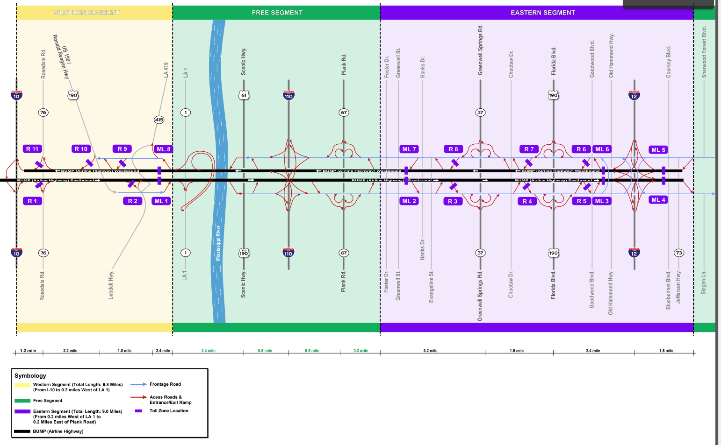
Tolling Configuration (developed by HNTB)
4 Mainline toll zones
6 Entrance ramp toll zones
5 Exit ramp toll zones

Slide 14
Traffic & Revenue (T&R) Analysis
HNTB performed a sketch level traffic and revenue spreadsheet model
14 access points
Used detailed travel demand and traffic information
Evaluated numerous toll rates
Developed 30-year gross revenue stream
Forecast is preliminary in nature and assumptions and results would be refined as the project is developed

Slide 15
T&R Methodology and Assumptions
Travel demand projections based on Baton Rouge MPO’s travel demand models for two forecast years, 2017 and 2037
Travel time savings based on typical travel time during four time periods: morning, midday, afternoon and night
Willingness to pay and value of travel based on review of local studies and national practice
Ramp-up factors were used to adjust the revenue stream at the beginning years

Slide 16
Summary of Rates, Time Savings, Performance
The vast majority of BUMP users are not diverting from I-10
Strong midday usage along US-61/US-190
Features |  |  | AM (6AM-9AM) ⁽¹⁾ | MD (9AM-3PM) | PM (3PM-6PM) | NT (6PM-6AM)
Toll Rates ($/mile) | $/mile |  | $0.20 (autos) $0.50 (trucks) | $0.2 | $0.2 | $0.2
Travel Time Savings Over competing corridor, minutes⁽²⁾ | I-10 | NB/WB SB/EB | Total daily: 11.6 Total daily: 8.0
 | Frontage roads | NB/WB SB/EB | 21 23 | 26 31.5 | 25 23.5 | 10.8 10.8
Revenue Distribution | during a typical weekday |  | 21% | 38% | 28% | 13%
Notes:
Time of day for four time periods obtained from Baton Rouge MPO Metropolitan Transportation Plan 2037 Travel Demand Model User’s Manual, June 2013
Travel times aggregated from Google Map Typical Traffic Time for each segment along the existing corridor. The travel time savings were the comparison between the built BUMP and frontage roads/local roads.

Slide 17
30-Yr Gross Revenue Stream ($2014)
Order | Year | Daily Gross Revenue | Annual Gross Revenue | Cumulative Gross Revenue | Annual Transactions
1 | 2022 | $85,950 | $27,074,250 | $27,074,250 | 27,018,800
2 | 2023 | $98,590 | $31,055,850 | $58,130,100 | 30,980,700
3 | 2024 | $111,320 | $35,065,800 | $93,195,900 | 34,969,300
4 | 2025 | $124,140 | $39,104,100 | $132,300,000 | 38,982,400
5 | 2026 | $124,590 | $39,245,850 | $171,545,850 | 39,110,300
6 | 2027 | $125,040 | $39,387,600 | $210,933,450 | 39,238,300
7 | 2028 | $125,490 | $39,529,350 | $250,462,800 | 39,366,300
8 | 2029 | $125,940 | $39,671,100 | $290,133,900 | 39,494,200
9 | 2030 | $126,390 | $39,812,850 | $329,946,750 | 39,622,200
10 | 2031 | $126,840 | $39,954,600 | $369,901,350 | 39,750,200
11 | 2032 | $127,290 | $40,096,350 | $409,997,700 | 39,878,200
12 | 2033 | $127,740 | $40,238,100 | $450,235,800 | 40,006,100
13 | 2034 | $128,190 | $40,379,850 | $490,615,650 | 40,134,100
14 | 2035 | $128,640 | $40,521,600 | $531,137,250 | 40,262,000
15 | 2036 | $129,090 | $40,663,350 | $571,800,600 | 40,390,000
16 | 2037 | $129,540 | $40,805,100 | $612,605,700 | 40,508,800
17 | 2038 | $129,990 | $40,946,850 | $653,552,550 | 40,636,700
18 | 2039 | $130,440 | $41,088,600 | $694,641,150 | 40,764,700
19 | 2040 | $130,890 | $41,230,350 | $735,871,500 | 40,892,700
20 | 2041 | $131,340 | $41,372,100 | $777,243,600 | 41,020,700
21 | 2042 | $131,790 | $41,513,850 | $818,757,450 | 41,148,600
22 | 2043 | $132,240 | $41,655,600 | $860,413,050 | 41,276,600
23 | 2044 | $132,690 | $41,797,350 | $902,210,400 | 41,404,500
24 | 2045 | $133,140 | $41,939,100 | $944,149,500 | 41,532,500
25 | 2046 | $133,590 | $42,080,850 | $986,230,350 | 41,660,500
26 | 2047 | $134,040 | $42,222,600 | $1,028,452,950 | 41,788,500
27 | 2048 | $134,490 | $42,364,350 | $1,070,817,300 | 41,916,400
28 | 2049 | $134,940 | $42,506,100 | $1,113,323,400 | 42,044,400
29 | 2050 | $135,390 | $42,647,850 | $1,155,971,250 | 42,172,400
30 | 2051 | $135,840 | $42,789,600 | $1,198,760,850 | 42,300,300

Slide 18
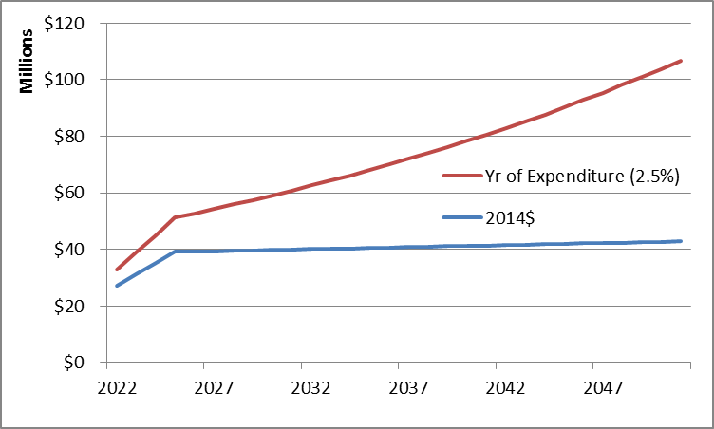
Revenue Forecast Comparison
HNTB Toll Revenue Forecast

Slide 19
Peer Review Discussion
Baez Consulting reviewed the methodology and assumptions of HNTB’s T&R report
Baez and HNTB discussed reasonableness of assumptions and similar facility comparables
Key areas of discussion from Baez Report
    Value of Time (VOT)
    Traffic Capture Rates
    Revenue Daily Distribution
    Revenue Days
    Ramp-up Factor
    Toll Sensitivity Curves and Toll Rates
    Truck Percentage
    Avg Daily Traffic Opening Yr
    Long Term Traffic Growth
    Revenue Days
    Ramp-up Factor

Slide 20
Financial Feasibility
Evaluate the private P3 financing potential of BUMP as a standalone project (no state support)
Load project inputs into a financial model
    Capital Cost, O&M/Lifecycle, Revenue
Develop financial assumptions based on current market, recent transactions and qualitative factors
  Debt rates, coverage levels, private equity IRR
Identify any shortfalls or gap funding required
Results are preliminary and the P3 developer could have a different T&R and financing package

Slide 21
Key Assumptions
50-Year Toll Concession
40-Year Private Activity Bonds Senior Debt
Federal TIFIA Loan
2.5% inflation for costs and revenues
2 financing scenarios analyzed
    Market Stabilized Case (normalized over time for conservatism)
    Attractive Financing Case (current rates and leverage environment)

Slide 22
Scenario Assumptions

Slide 23
Summary of Results
($M) | Mkt. Stabilized | Attractive
Capital Cost (esc) | 877 | 877
Sr. Debt Proceeds | 195 | 250
TIFIA Debt Proceeds | 185 | 240
Private Equity | 100 | 103
Total Upfront Proceeds | 480 | 593
Gap Funding Required | 397 | 284
Feasibility Percentage* | 55% | 68%
Disclaimer:
Results of the financing proceeds and gap funding will change over time as costs and revenues are refined. Financial market conditions at the time of financial close will dictate the financial terms.
Preliminary, subject to change. Does not represent or recommend an actual financing or transaction. HNTB is not a registered financial advisor.

Slide 24
Findings
¹ The estimated roadway capital costs shall be considered a preliminary conceptual estimate. The preliminary level of development, potential for increases in the scope of work and history of significant variability in costs associated with the development of large, complex projects require continual refinement and additional scrutiny of the estimated costs.
² The financing capacity of the project will change as project costs and revenues are refined over time. Results of the financing capacity are subject to future market conditions.
 | HNTB Feasibility Evaluation
Capital Cost (esc) | $775 M¹
Feasibility % | 55-68%²
Gap Funding | $284-397 M
Disclaimer:
Preliminary, subject to change. Does not represent or recommend an actual financing or transaction. HNTB is not a registered financial advisor.

Slide 25
Questions

